Slide 1
STAT 350 Lab
Stanley Coulter 231
3:30PM, January 24th, 2017
Zhaoxin Luo
Office Hours: Thursdays 10:00AM – 12:00AM, HAAS 115

Slide 2
Logistics
Lab 1
Information encoded by numbers does not make a variable numerical.
On labs and reports
Clearly state your section time (and TA)
Please include only relevant code
Re-submission due to Blackboard issues
Any other question (general/Lab 1)?

Slide 3
Outline
Features of a Data Distribution
Numerical Summaries
Histograms (with curves)
(Modified) Boxplots
Concepts to Note
Symmetry and Skewness
Measures of Center
Compare Mean and Median
Lab 2 Details
Notes:
In standard boxplots, the outliers are not displayed. In modified boxplots, outliers based on the 1.5-IQR rule are marked explicitly.

Slide 4
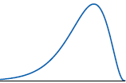
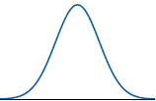
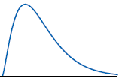
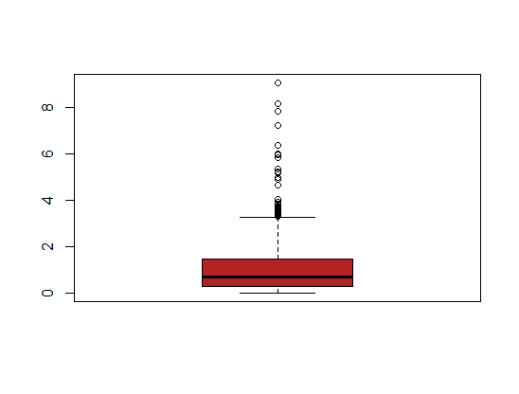
Symmetry & Skewness
Left-skewed
Symmetric
Right-skewed
Right skewness:

Slide 5
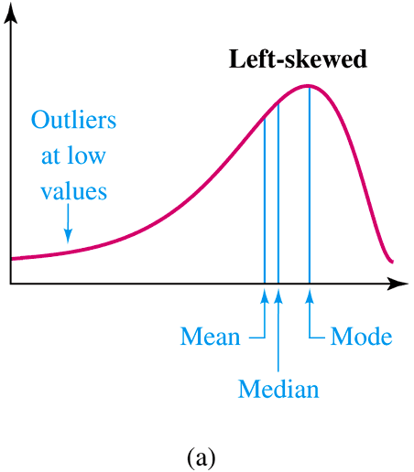
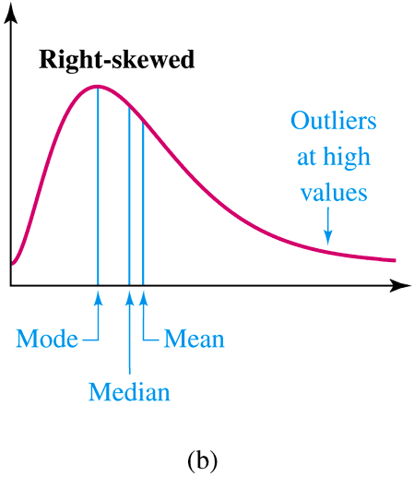
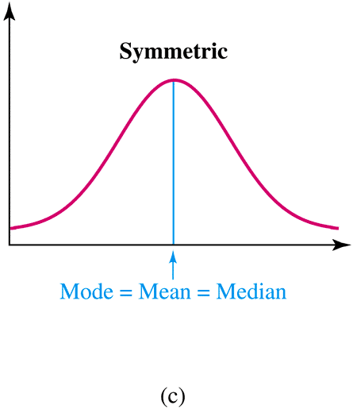
Symmetry & Skewness
Right skewness:

Slide 6
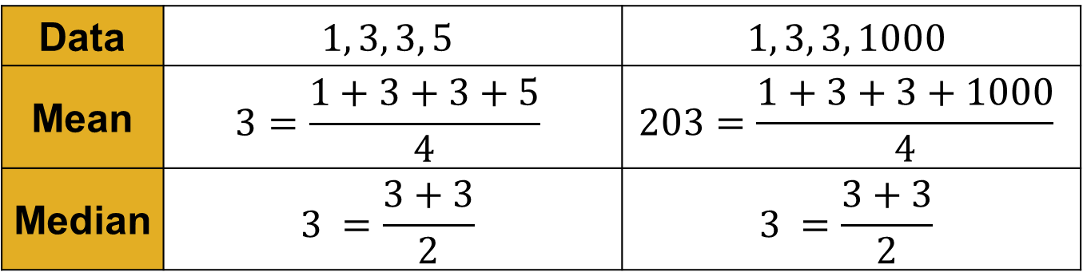
Measures of Center
Data | $$1, 3, 3, 5$$ | $$1, 3, 3, 1000$$
Mean | $$3=\frac{1+3+3+5}{4}$$ | $$203=\frac{1+3+3+1000}{4}$$
Median | $$3 =\frac{3+3}{2}$$ | $$3 =\frac{3+3}{2}$$
For distributions that are roughly symmetric, either Mean or Median is okay.
Median is robust against strong skewness or outliers.
Example: Distribution of income.

Slide 7
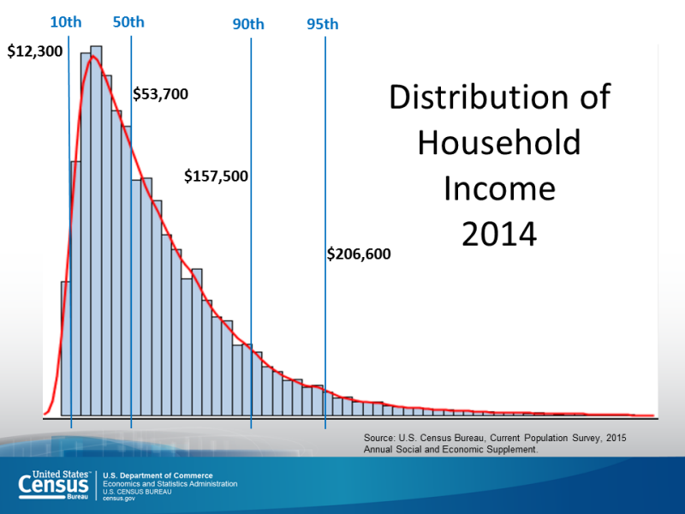
Measures of Center

Slide 8


Compare Two Numbers
Case 1: Time to finish lab
1.0 hour vs. 1.5 hours, 3600 seconds vs. 5400 seconds
Case 2: Height of Pokemons
Pikachu: 0.4m vs. 0.45m
Snorlax: 2.1m vs. 2.4m
https://pkmngotrading.com/wiki/Height

Slide 9

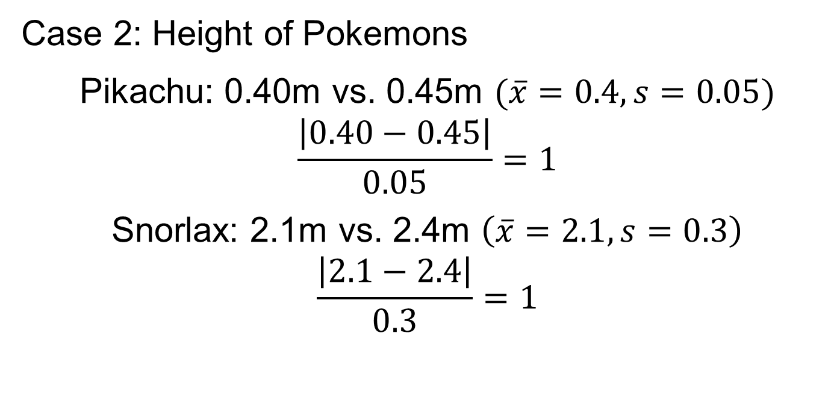
Compare Two Numbers
Case 2: Height of Pokemons
Pikachu: 0.40m vs. 0.45m $(\overline{x}=0.4, s=0.05)$
$$\frac{\left|0.40−0.45\right|}{0.05}=1$$
Snorlax: 2.1m vs. 2.4m $\left(\overline{x}=2.1, s=0.3\right)$
$$\frac{\left|2.1−2.4\right|}{0.3}=1$$
https://pkmngotrading.com/wiki/Height

Slide 10
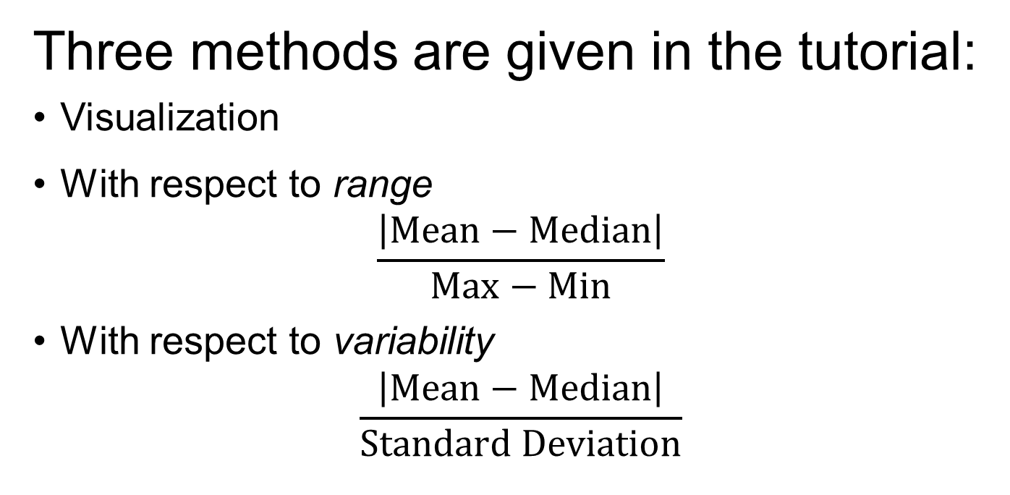
Compare Mean & Median
Three methods are given in the tutorial:
Visualization
With respect to range
$$\frac{\left|\text{Mean}−\text{Median}\right|}{\text{Max}−\text{Min}}$$
With respect to variability
$$\frac{\left|\text{Mean}−\text{Median}\right|}{\text{Standard} \text{Deviation}}$$

Slide 11
Lab 2 Tutorial
Read tutorial before assignment
Read code comments
Find assignment hints in tutorial; Copy, modify, paste
Use the cleaned data you made in Lab 1
On lab report
Include all code in part 1
Output: relevant code and necessary notes
Histograms: two curves; number of bins
Notes:
Read tutorial before assignment: (1) before attempting the assignment, and/or (2) before coming to the lab.

Slide 12
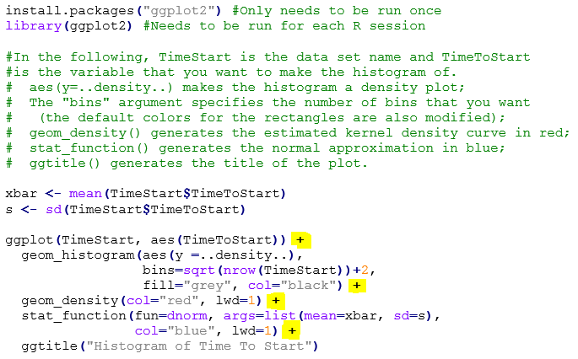
Lab 2 Tutorial
Using descriptive names
Notes:
Explain the background about library's. Go over how to use the library. Load in the package once (I do not know if this is transferable to other ITAP computers), but you need to load the library each session.

Slide 13
Outline
Features of a Data Distribution
Numerical Summaries
Histograms
(Modified) Boxplots
Concepts to Note
Symmetry and Skewness
Measures of Center
Compare Mean and Median
Lab 2 Details

